Slide 1
DETECTION OF PARKINSON’S DISEASE

Slide 2
What is Parkinsons Disease?
Parkinson’s disease is a progressive disorder of the central nervous system affecting movement and inducing tremors and stiffness.
It has 5 stages to it and affects more than 1 million individuals every year in India. This is chronic and has no cure yet.
It is a neurodegenerative disorder affecting dopamine-producing neurons in the brain.

Slide 3
Objective
Parkinson’s disease is a chronic progressive disease of the nervous system characterized by the cardinal features of rigidity, tremor and postural instability.
Data mining techniques can be used for the extensive classification of medical data.
The aim of this data mining project is to develop classifiers to distinguish between a normal and affected person.

Slide 4
Dataset
This dataset is collected from UCI Machine Learning Repository.
The dataset has 24 columns and 195 records.
Speech signal processing algorithms such as Time Frequency Features, Mel Frequency Cepstral Coefficients (MFCCs), Wavelet Transform based Features, Vocal Fold Features and TWQT features have been applied to the speech recordings of Parkinson's Disease (PD) patients to extract clinically useful information for PD assessment.

Slide 5
Literature Review
[1] Machine Learning Approaches for DetectingParkinson’s Disease from EEG Analysis:A Systematic ReviewAna María Maitín 1, Alvaro José García-Tejedor 1 and Juan Pablo Romero Muñoz.
[2] Shamrat, F.J.M., Asaduzzaman, M., Rahman, A.S., Tusher, R.T.H. and Tasnim, Z., 2019. A comparative analysis of Parkinson disease prediction using machine learning approaches. International Journal of Scientific & Technology Research, 8(11), pp.2576-2580.
[3] Soumaya, Z., Taoufiq, B.D., Benayad, N., Yunus, K. and Abdelkrim, A., 2021. The detection of Parkinson disease using the genetic algorithm and SVM classifier. Applied Acoustics, 171, p.107528.
[4] Deng, Z., Zhu, X., Cheng, D., Zong, M. and Zhang, S., 2016. Efficient kNN classification algorithm for big data. Neurocomputing, 195, pp.143-148.

Slide 6
Domain
Domain: Data mining
Language: Python
Algorithms: classifiers(XGB boost), SVM, KNN, Random forest
Tool: Jupyter
Dataset:UCI ML Parkinsons dataset

Slide 7
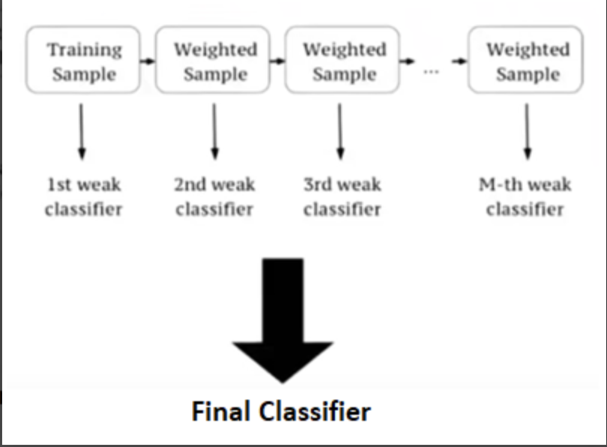
what is XGBoost?
XGBoost is a new Machine Learning algorithm designed with speed and performance in mind. XGBoost stands for eXtreme Gradient Boosting and is based on decision trees.
In this algorithm, decision trees are created in sequential form. Weights play an important role in XGBoost. Weights are assigned to all the independent variables which are then fed into the decision tree which predicts results.
Weight of variables predicted wrong by the tree is increased and these the variables are then fed to the second decision tree.
These individual classifiers/predictors then ensemble to give a strong and more precise model.

Slide 8
Implementation of XGBoost in this project
In this project, we will import the XGBClassifier from the xgboost library; this is an implementation of the scikit-learn API for XGBoost classification.
We’ll load the data, get the features and labels, scale the features, then split the dataset, build an XGBClassifier, and then calculate the accuracy of our model.

Slide 9
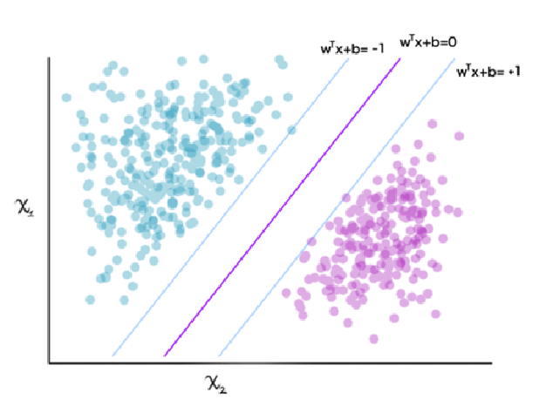
Support Vector Machine
Attempts to draw a hyperplane to classify data in in-dimensional space
The hyperplane is the plane that most optimally separates the data points
Generates optimal hyperplane iteratively, which is used to minimize an error.

Slide 10
Support Vector Machine
Can be used for regression as well as classification tasks
Gives high accuracy compared to decision trees and logistic regression
This high accuracy is also achieved with less computational resources
Transforms input space to a higher dimensional space using kernel trick allowing it to perform non-linear classifications
Used in applications such as handwriting detection, image classification, face detection, etc.

Slide 11
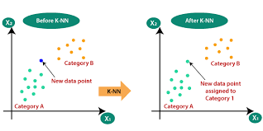
KNN Algorithm
NN rule classifies a sample based on the category of its nearest neighbor.
Class label of its closest neighbor to a test pattern.
In KNN, ‘k’ neighbors are found.
Majority class of k nearest neighbors is the class label assigned to the new pattern.

Slide 12
KNN Algorithm
This method is efficient for reducing errors.
The value of K is deterministic.
K-Nearest Neighbors (KNN ) algorithm, is one of the most powerful utilized algorithms of machine learning that is widely used both for regression as well as classification tasks.
To predict and examine the class of datapoint, it will examine the label of chosen data points surrounded by the target point.

Slide 13
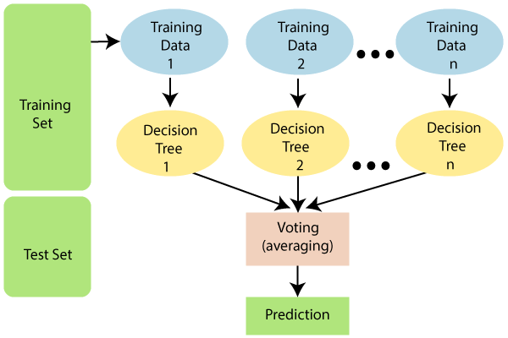
Random Forest Algorithm
Random forest is a supervised learning algorithm. The "forest" it builds, is an ensemble of decision trees, usually trained with the “bagging” method. The general idea of the bagging method is that a combination of learning models increases the overall result.

Slide 14
Random Forest Algorithm
The greater number of trees in the forest leads to higher accuracy and prevents the problem of overfitting.
Below are some points that explain why we should use the Random Forest algorithm:
It takes less training time as compared to other algorithms.
It predicts output with high accuracy, even for the large dataset it runs efficiently.
It can also maintain accuracy when a large proportion of data is missing.

Slide 15
Thank You

